Slide 1

ICM Process

Slide 2
Introduction
Cloud PC Lifecycle – Grace Period Overview
When a Windows 365 license is removed, the Cloud PC enters a grace period before deprovisioning.
Grace period scenarios:
License expires due to payment failure.
User removed from group where license is inherited.
Direct license assignment removed.
User removed from group tied to provisioning policy.
Duration:
Enterprise: 7 days
Business: 7 days
After grace period
Passive deletion: License expiry → Snapshot available for recovery.
Active deletion: Admin action → No snapshot available.
Support engineers must determine if deprovision was active (Deleted) or passive (Suspended).
Passive: Raise IcM to SaaF for recovery.
Active: Inform customer recovery is not possible.

Slide 3
Cloud PC Data Recovery Template.
When customer request for data recovery for their Cloud PC because of passive (End of Grace Period, Trial License Expire or Delete by mistake) delete, we have now a template in place to gather all the information which is needed for successful data recovery for customer.
To Do -> CSS
If a customer opens a Rave case for Data Recovery of their cloud PC, please get the information below from customer:
How did the Cloud PC get deleted? Reason for the cloud PC missing. Due to the non-time payment
Subscription Name: Windows 365 Business 2 vCPU, 8 GB, 128 GB Deactivated on 5th March and re-activated on 7th March
Name of the Cloud PC: CPC-tdaws-9U46Y
Tenant ID: 40db74aa-ac66-463d-b0f9-eefefa9f2384
Location/Region of Cloud PC : eastus2
User-ID of whose CPC was deleted: ?
Timestamp when the CPC was deleted: Not aware

Slide 4
Create ICM after getting the above information.
To DO -> Customer
If a customer does not have a Storage Account (SA) already in the same tenant ID as the deleted CPC then they will have to follow the steps below to create a new SA and Container in the same Tenant ID as CPC.
Customer must create a Storage Account in the same Tenant where the Cloud PC was residing.
Set up your Azure storage account
To recover data of deleted Cloud PC, customer must create Azure storage account in the same tenant as the Cloud PC.
Create a Storage Account in the same subscription as your Azure Network Connection. To create the account, you can use PowerShell, Azure CLI, Azure Resource Manager Template, or Azure portal.
Resource Group Name: vgroup
Subcription ID: ee41d46e-1161-45b9-bd39-b917f53e3511
Storage account Nama: vgroup2
Container Name: backup

Slide 5
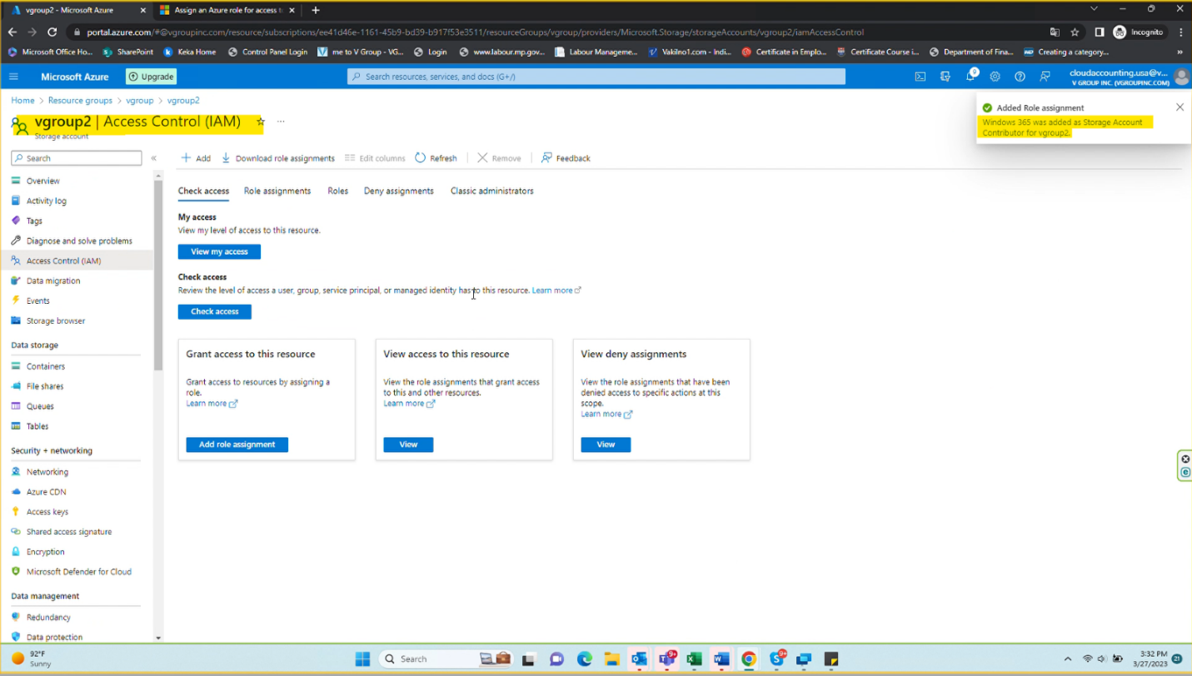
Resource Group Name: vgroup Subscription ID: ee41d46e-1161-45b9-bd39-b917f53e3511
Storage account Nama: vgroup2
Container Name: backup
2. For best performance, configure the storage account with the following settings.
Premium Page Blob performance : Customer selected Standard Performance
3. Assign an Azure role for access to blob data. The minimum permission required for the Windows 365 service is Storage Account Contributor and Storage Blob Data Contributor. This permission can be given under “Access Control” for the SA.
Windows 365/CloudPC has been added as Storage Account Contributor for Storage Account vgroup2

Slide 6
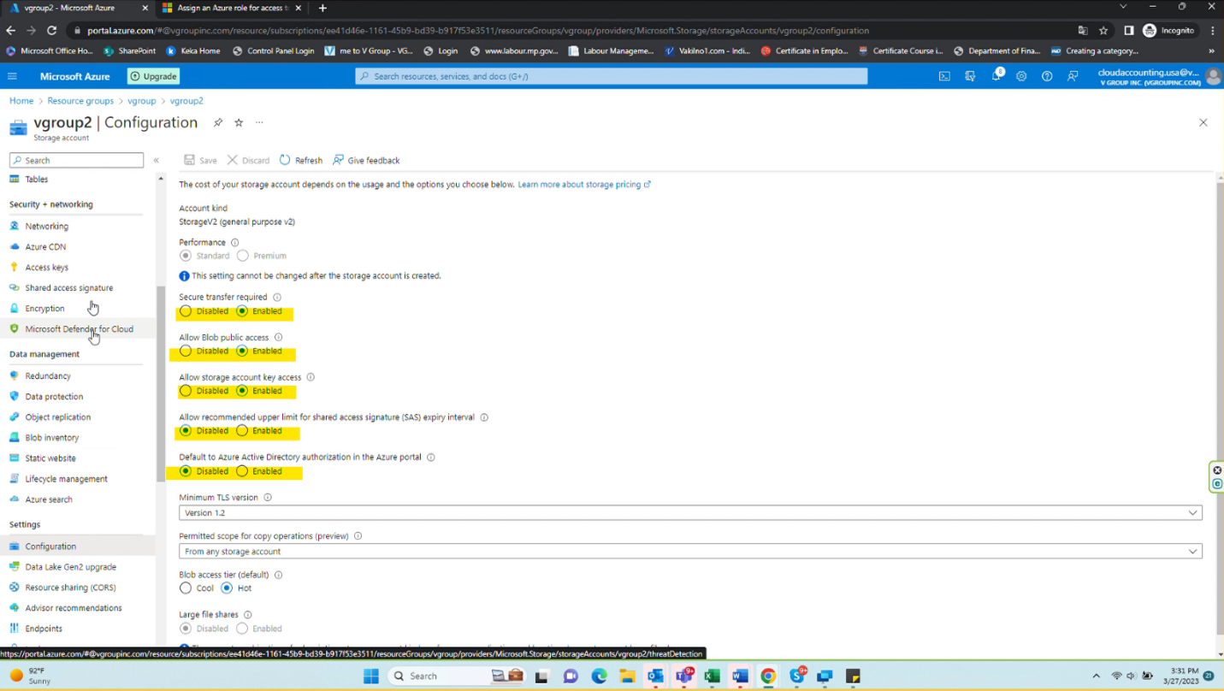
4. Next, “Enable” Allow Storage Account key access, from Configuration Tab from the left. This is done. 5. The last step is to create a new container and ask customer to share the container name. This is done. Container Name in customer storage account: backup

Slide 7
You can use the below Kusto to get the above information.
let TenantID = '982dabc5-3b5c-4048-b8f2-f55ef6043e9f';
let UserID = '';
cluster('cloudpc.eastus2.kusto.windows.net').database('CloudPC').CloudPCEvent
| union cluster('cloudpcneu.northeurope.kusto.windows.net').database('CloudPCProd').CloudPCEvent
| where ApplicationName has_any ("SchdlrFunction", "schdlr", "RMFunction")
| where EventUniqueName contains "GetUsersLicensesAsync"
| where AccountId == TenantID
| where OtherIdentifiers contains UserID
| where Col1 contains "CapabilityStatus"
| extend Col1 = extract("\\{.*", 0, Col1)
| extend Col1 = todynamic(strcat("[", Col1, "]"))
| mv-expand userObject = Col1
| mv-expand assignedPlan = userObject.assignedPlans
| extend UserNumber = toint(extract("(\\d+)", 1, tostring(userObject.userId)))
| extend UserIds = split(OtherIdentifiers, ",")
| extend UserObjectId = UserIds[UserNumber]
| project TimeStamp=env_time, UserObjectId, servicePlanId = assignedPlan.servicePlanId, servicePlanType = assignedPlan.servicePlanType, assignedDateTime = assignedPlan.assignedDateTime,capabilityStatus = assignedPlan.capabilityStatus

Slide 8
Once we have the below information, ready to create ICM
User ID
Device ID of deleted CPC.
Region
ServicePlanID
Subscription ID
Tenant ID name-
TenantID
Customer SA account details (Container Name and SubID and SA Name)
Manage Virtual Hard Disks (VHD) | Microsoft Learn – public article
Mount VHD on Azure VM after placing Cloud PC under review – Overview – private article
Place a Cloud PC under review | Microsoft Learn – cloud place under review
Create an Azure storage account - Azure Storage | Microsoft Learn – storage account

Slide 9
